Slide 1
LLM MoE Multicast use case
https://datatracker.ietf.org/doc/draft-zhang-rtgwg-llmmoe-multicast/
IETF 123 Madrid
Sandy Zhang (ZTE)

Slide 2
LLM MoE Introduction
MoE (Mixture of Experts) is a popular architecture in LLM (Large Language Model), where multiple experts are activated during the computation and only part of the parameters are used for each expert.
MoE brings a more cost-effective training and inference method. It enables the deployment of larger models at almost the same cost. More and more LLMs adopt MoE, such as DeepSeekV3, Llama 4, Mixtral, Qwen3, etc.
Using the gating function, a token is sent to multiple selected experts. This is a typical multicast use case.

Slide 3
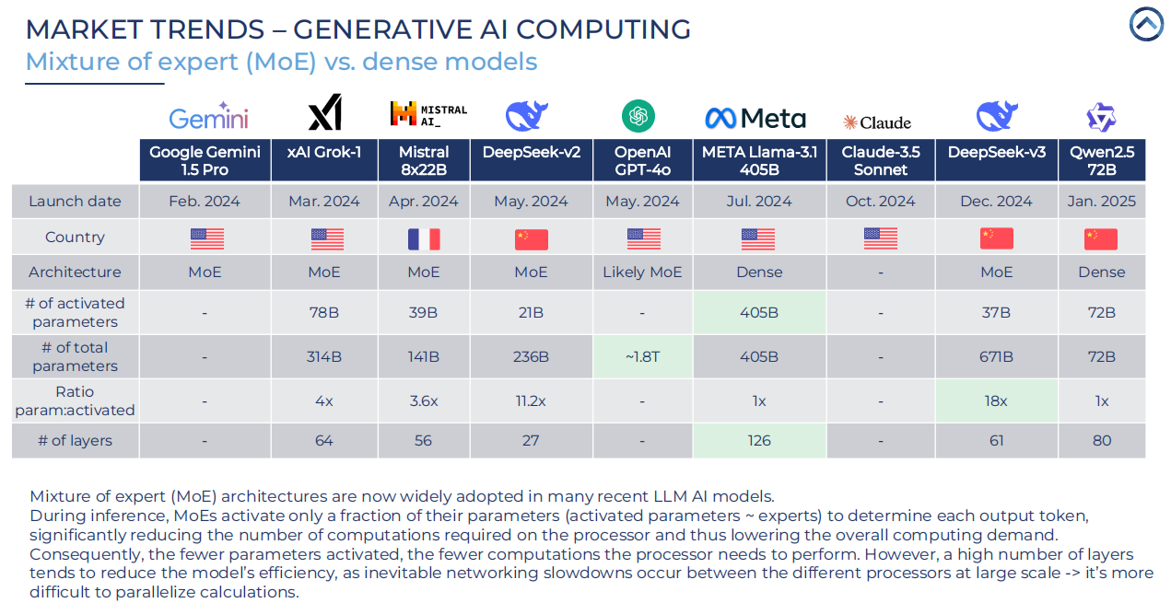
The MoE deployments
Mixtral-8x7B has 8 experts, two experts are activated at a time.
In Llama 4, Scout has 16 experts, Maverick has 128 experts, two experts are activated at a time.
DeepSeekV3 has 256 experts, 9 of which are activated at a time: one shared expert and eight routing experts.

Slide 4
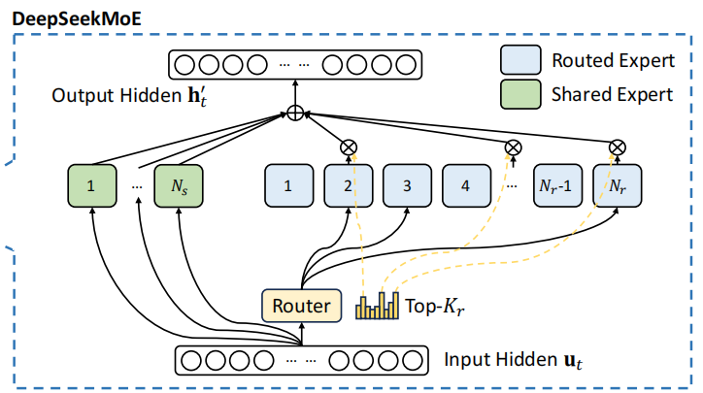
LLM MoE (DeepSeekV3)
Using the gating function, tokens are sent to multiple selected experts.
Since experts need to be balanced, it is difficult to always use the same set of experts.
Experts are distributed across different GPUs and nodes, so it is difficult to restrict the selected experts to one node.
The communication of EP (Expert parallelism) may span leaf switches or even spine switches.
A token is sent to multiple selected experts.
This is a typical multicast use case, and just one of many.

Slide 5
The motivation
Use network multicast technology to assist LLM multicast implementation
Reduce the pressure on the source GPU
Reduce the possibility of congestion caused by bandwidth between nodes
Finding the possibility of using multicast method for use cases inside and outside nodes

Slide 6
GAP
Currently, the sending methods within the card (memory reading), between cards (Nvlink), and between nodes (RDMA) are inconsistent.
Coordination between large model coding, communication library, network card, and network layer
Location and encapsulation of multicast
Management by experts (MoE scenario)

Slide 7
Existed network multicast technologies
PIM
Traditional multicast routing protocols
Stateful: The state of each flow needs to be maintained in the router
Requires periodic signaling to build a distribution tree to forward flows
Slow convergence if the tree topology changes
IP-based encapsulation
BIER
Novel multicast technology
Stateless: No need for per-group or per-stream state
No need to build a distribution tree, forwarding is done based on topology.
Faster convergence to network changes (no tree re-building needed)
BIER header encapsulation (Ethernet, MPLS and IPv6)

Slide 8
BIER Standards
BIER may be an ideal choice for implementing multicast in LLM, especially for MoE scenarios.
BIER technology is mature
Architecture: RFC8279
Underlay extensions: RFC9793 (BGP-based), RFC8401 (IS-IS based), RFC8444 (OSPF based)
Encapsulation: Ethernet (0xAB37), MPLS (RFC8296), IPv6 (BIERin6), U-BIER
BIER Traffic Engineering: RFC9262
Possibility of deploying BIER for scale up and scale out network

Slide 9
Open Questions
Do we need one multicast technology to solve all multicast use cases in LLM?
Do we need some specific technologies for some specific use cases (e.g. MoE)?

Slide 10
BIER in MoE
For MoE scenarios
Each expert can be considered as a BFER and appear as a bit in the Bitstring.
The token can be encapsulated in a BIER header and sent to selected experts via BIER forwarding on Leaf switches or even Spine.
Coordination with each expert batch may be required.

Slide 11
Thanks!

